Slide 1
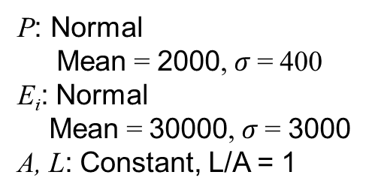
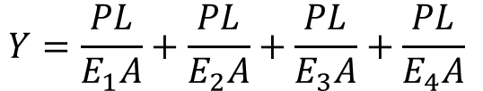
Homework problem (PCE Surrogate)
Four segments, each with a different E (Young’s modulus), all described by i.i.d Gaussian (normal) variables
P, Y
E₁, A, L
E₂, A, L
E₃, A, L
E₄, A, L
P: Normal
Mean = 2000, $σ$= 400
E_{i}: Normal
Mean = 30000, $σ$= 3000
A, L: Constant, L/A = 1
Extension of the bar (Original model)
$$Y=\frac{PL}{E_{1}A}+\frac{PL}{E_{2}A}+\frac{PL}{E_{3}A}+\frac{PL}{E_{4}A}$$
1. Build a 2nd order PCE surrogate model: Y = f(P, E₁, E₂, E₃, E₄)
2. Compute the probability distribution of Y, using both PCE and original model, and compare the two results.

